Slide 1
Welcome
21/02/2024
Year 7 Science

Slide 2
Learning Intentions
Introductions
Expectations

Slide 3
Success criteria
Know the name of everyone on your bench
Locate three safety features of the Science Lab
Know what to bring to class tomorrow

Slide 4
Introductions - Kaya
Mrs Johnson

Slide 5
Make a circle…

Slide 6

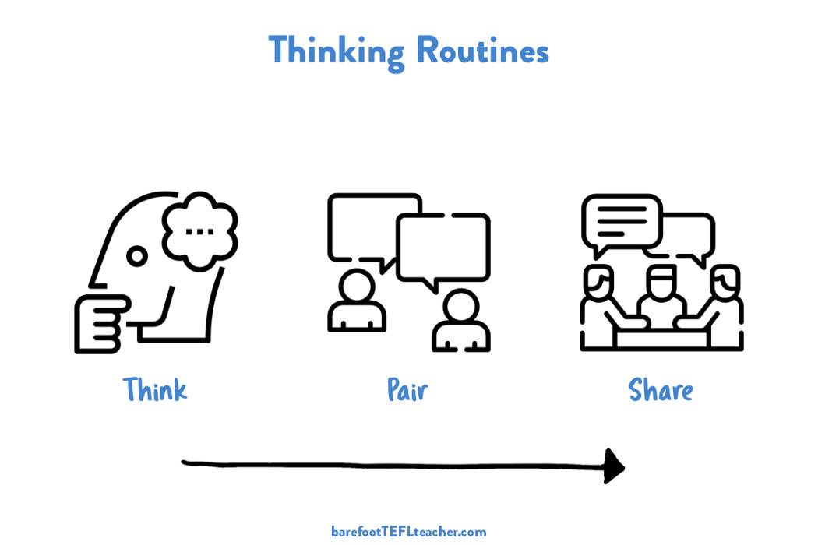
Expectations
Respect
Responsibility
Tolerance

Slide 7
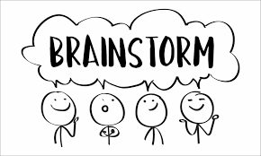
Expectations

Slide 8
What to bring

Slide 9

Getting to know your laboratory
Name and date on your sheet
Work individually or in pairs
Inside voices

Slide 10
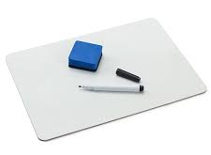
Science is…
knowledge
method

Slide 11
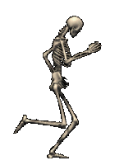
Knowledge
True or false - there are 206 bones in an adult human body and 300 bones in an infants body?
8:53 AM

Slide 12
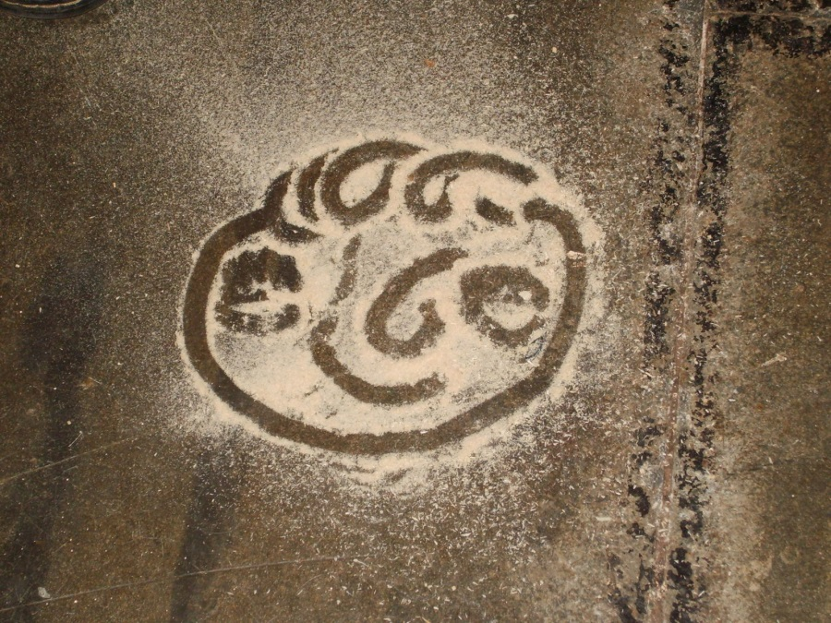
Knowledge
True or false- most of the dust in your home is made of human skin?

Slide 13
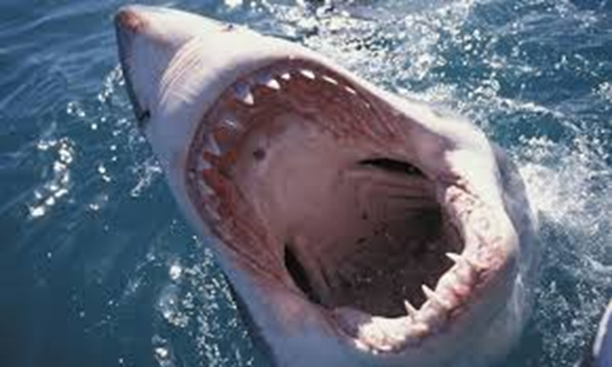
Knowledge
3. In terms of attributed human deaths, which are more dangerous; snakes, bees, sharks or house flies?

Slide 14
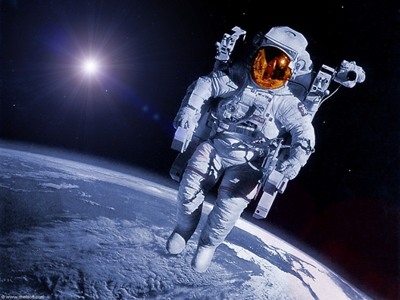
Knowledge
4. If you go into space, do you get taller?

Slide 15
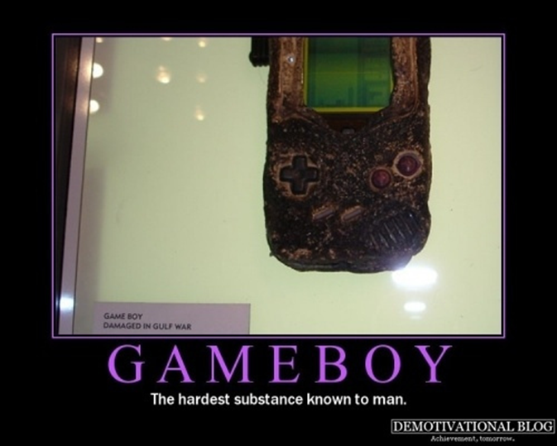
Knowledge
5. What is the hardest substance in the human body?

Slide 16
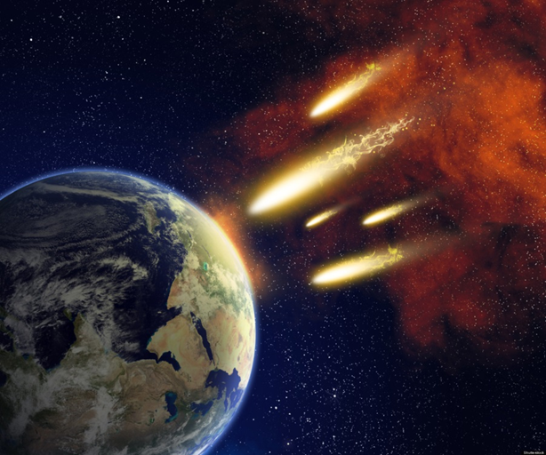
Knowledge
6. What survives impacting Earth's surface; a meteor, a meteorite or an asteroid?

Slide 17
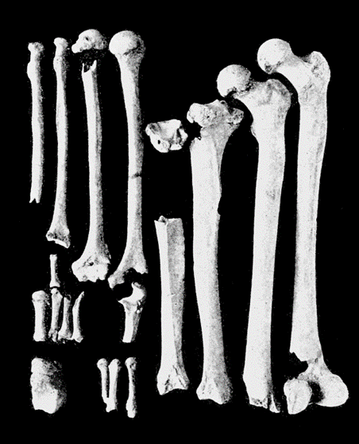
Knowledge
7. Where are the three smallest bones in the human body?

Slide 18
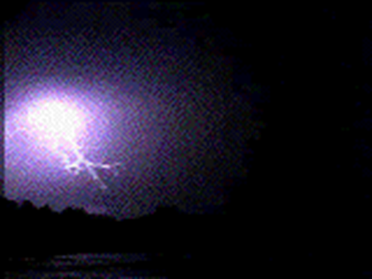
Knowledge
8. True or false - is lightning 3 times hotter than the Sun?

Slide 19
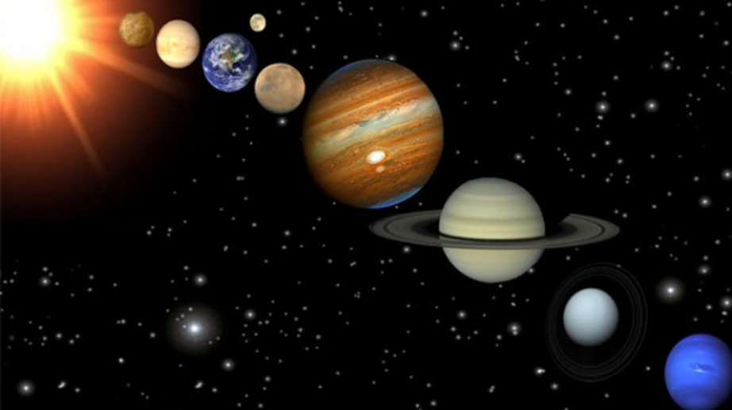
Knowledge
9. Which is the hottest planet in the solar system?

Slide 20
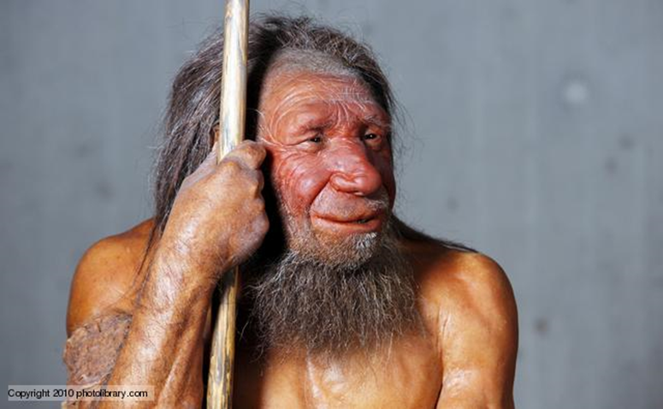
Knowledge
10. True or false; A modern human's brain is smaller than a Neanderthal's brain?

Slide 21
Science is…
knowledge
method

Slide 22
Scientific method
Observe
Question
Hypothesise
Experiment
Theory

Slide 23
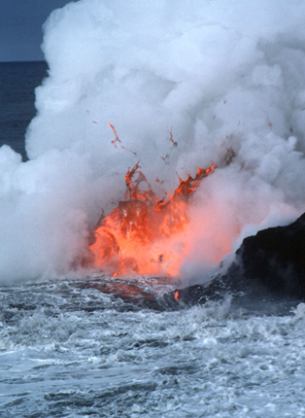
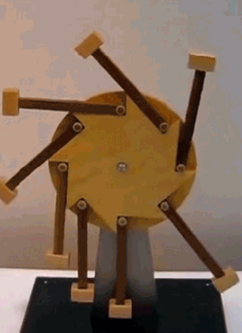
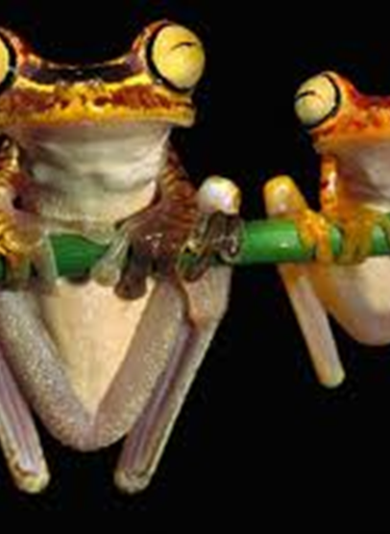
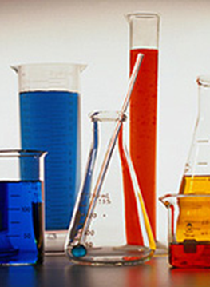
Fields of Science
Biology
Chemistry
Earth & Space
Physics

Slide 24
The answers…
1. True. Some bones in infants skulls have not yet fused together.
2. True - up to 70%!
3. House flies. They are vectors for disease causing bacteria.
4. Yes, the cartilage disks in your spine expand under zero gravity.
5. Tooth enamel.
6. Meteorite.
7. In the middle ear. Collectively called ossicles, the 3 bones are the Malleus (hammer), Incus (anvil) & Stapes (stirrup).
8. True
9. Venus, surface temperature 460ºC
10. True.

Slide 25
Questions?

